Slide 1
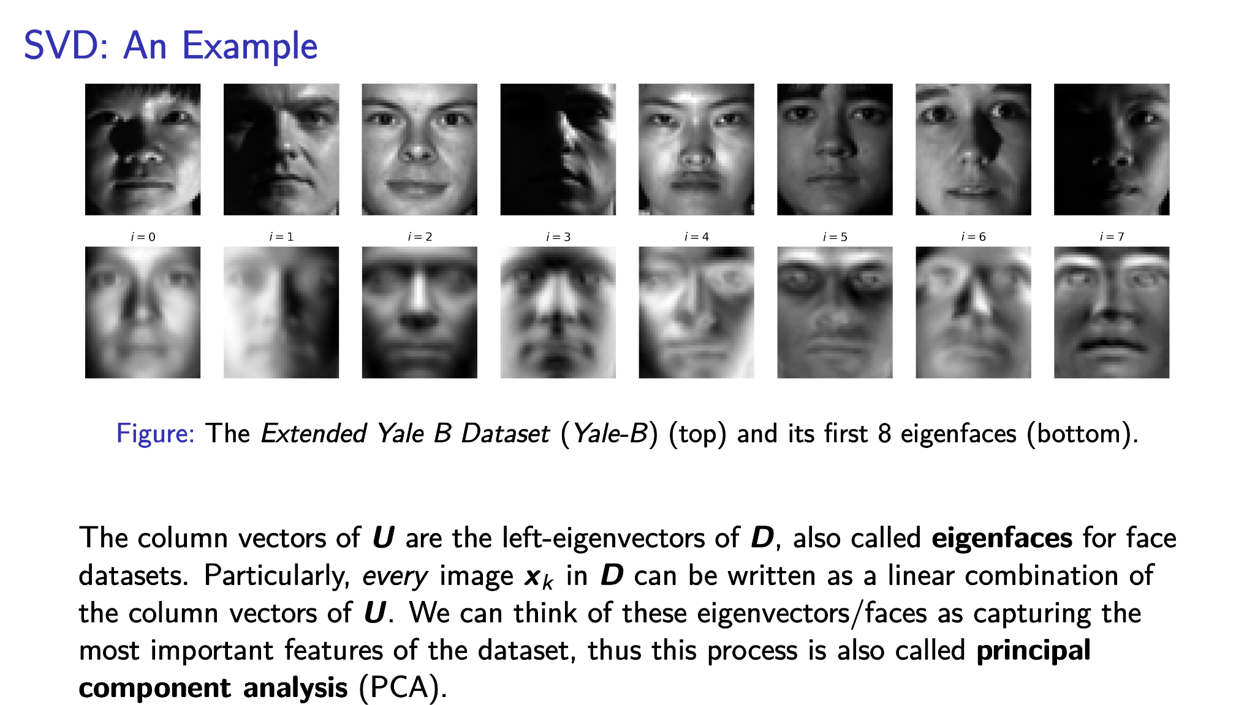
Singular Value Decomposition for Face Image Processing
Math 155 Final Project
Jordan, Lukas, Beisong, Huixian, and Kai
Follow along! We will be going through the slides quite quickly: https://bit.ly/math_155_project

Slide 2
Introduction
Introduction
Projection
Image Compression
Image Denoising
Tuning Light
Facial Feature Recovery
Facial Classification

Slide 3
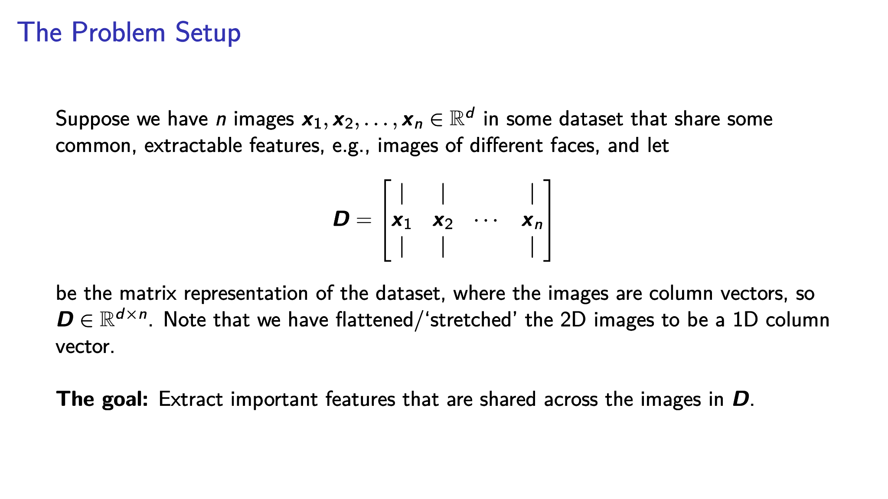

Slide 4
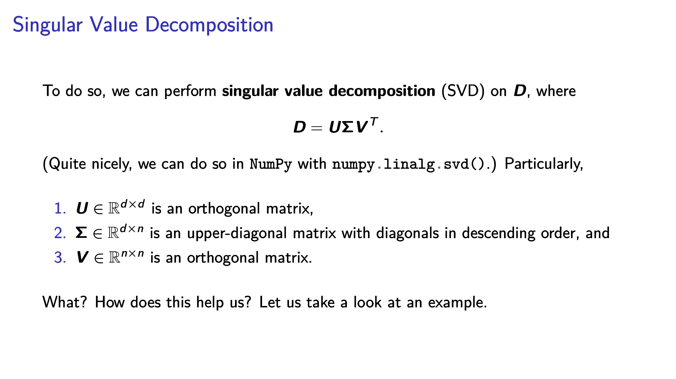

Slide 6
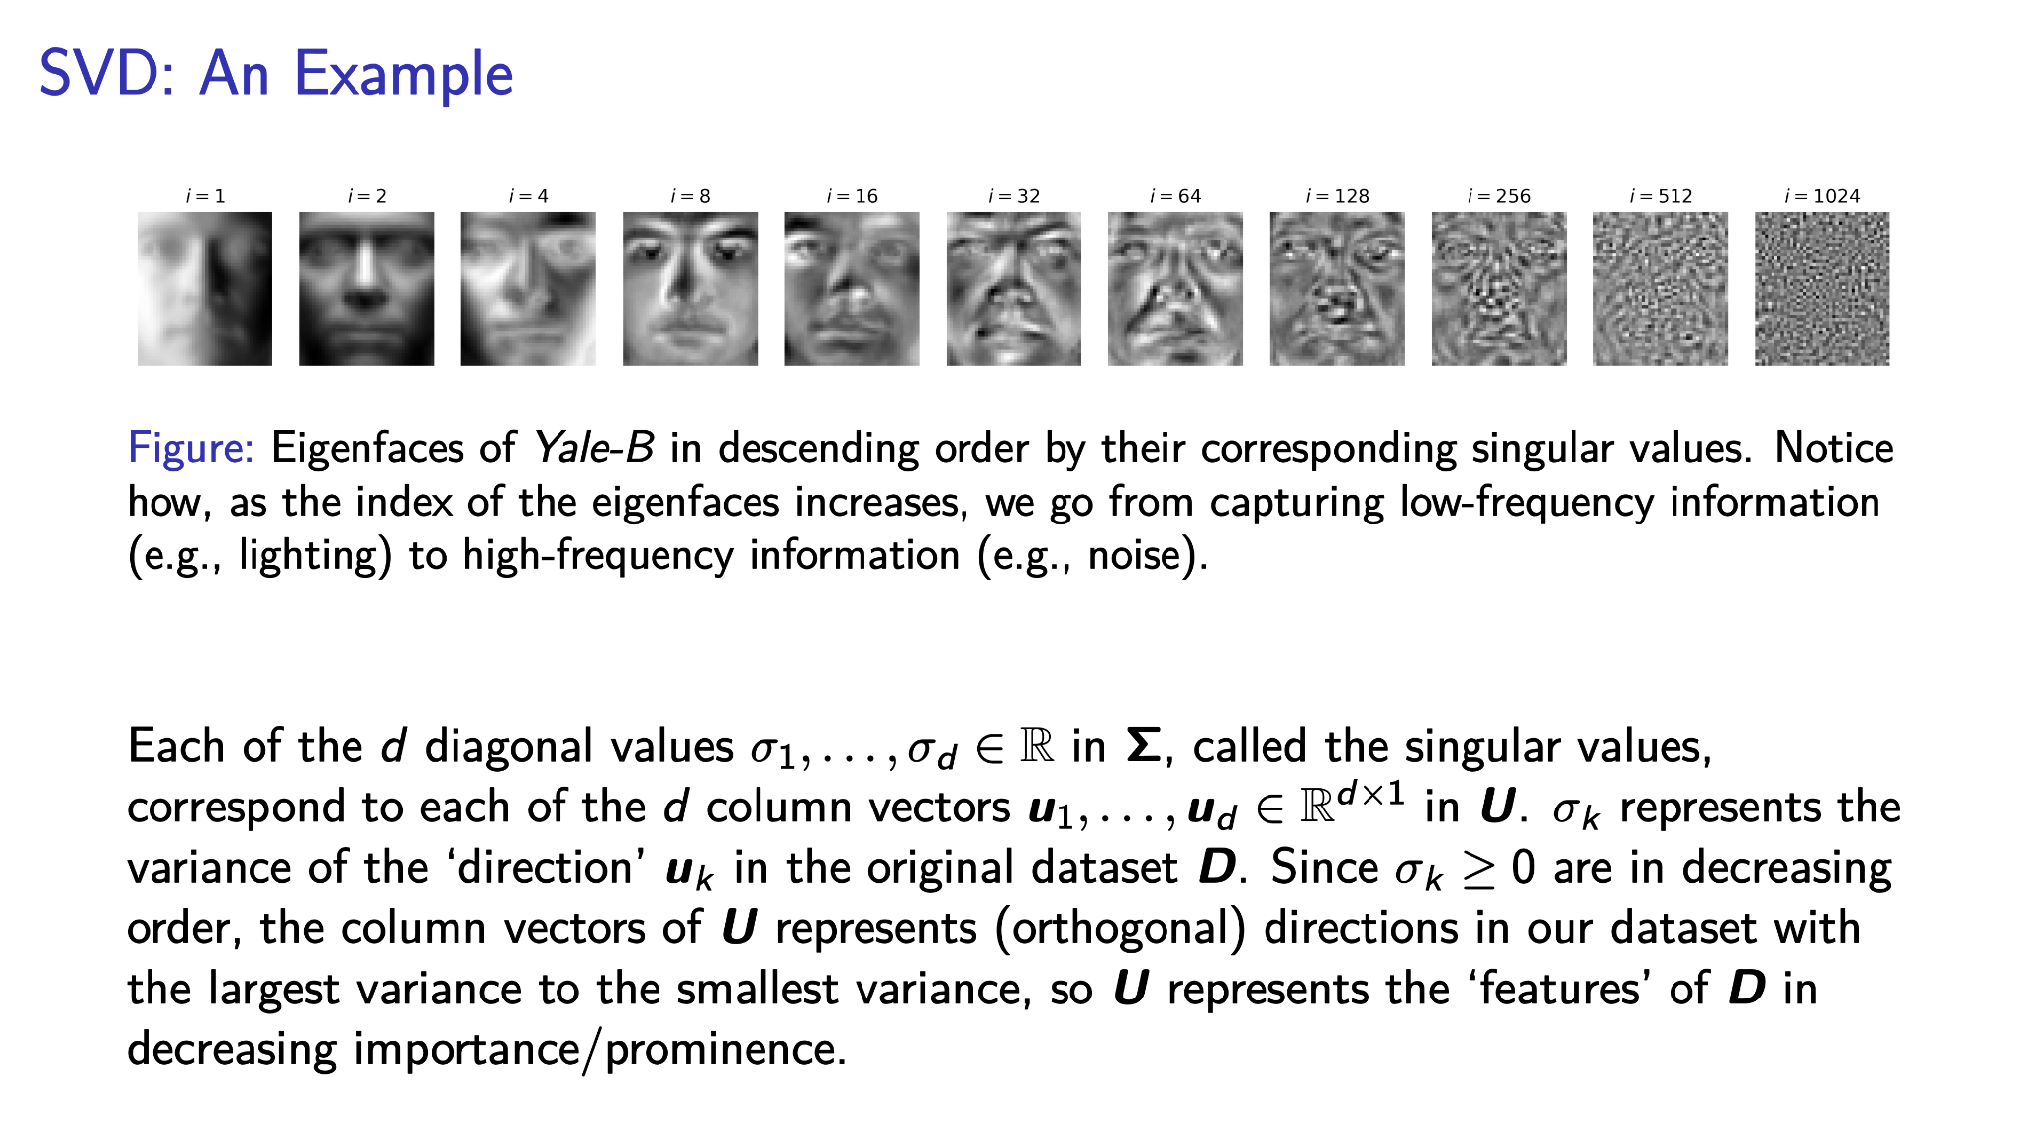

Slide 7
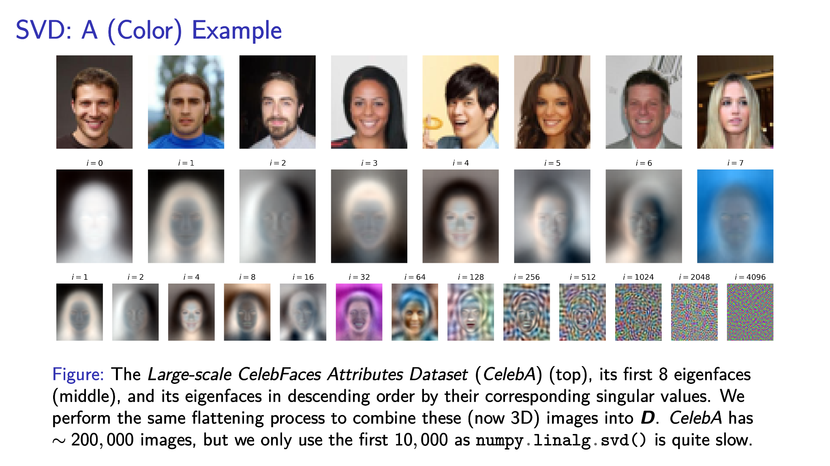

Slide 8
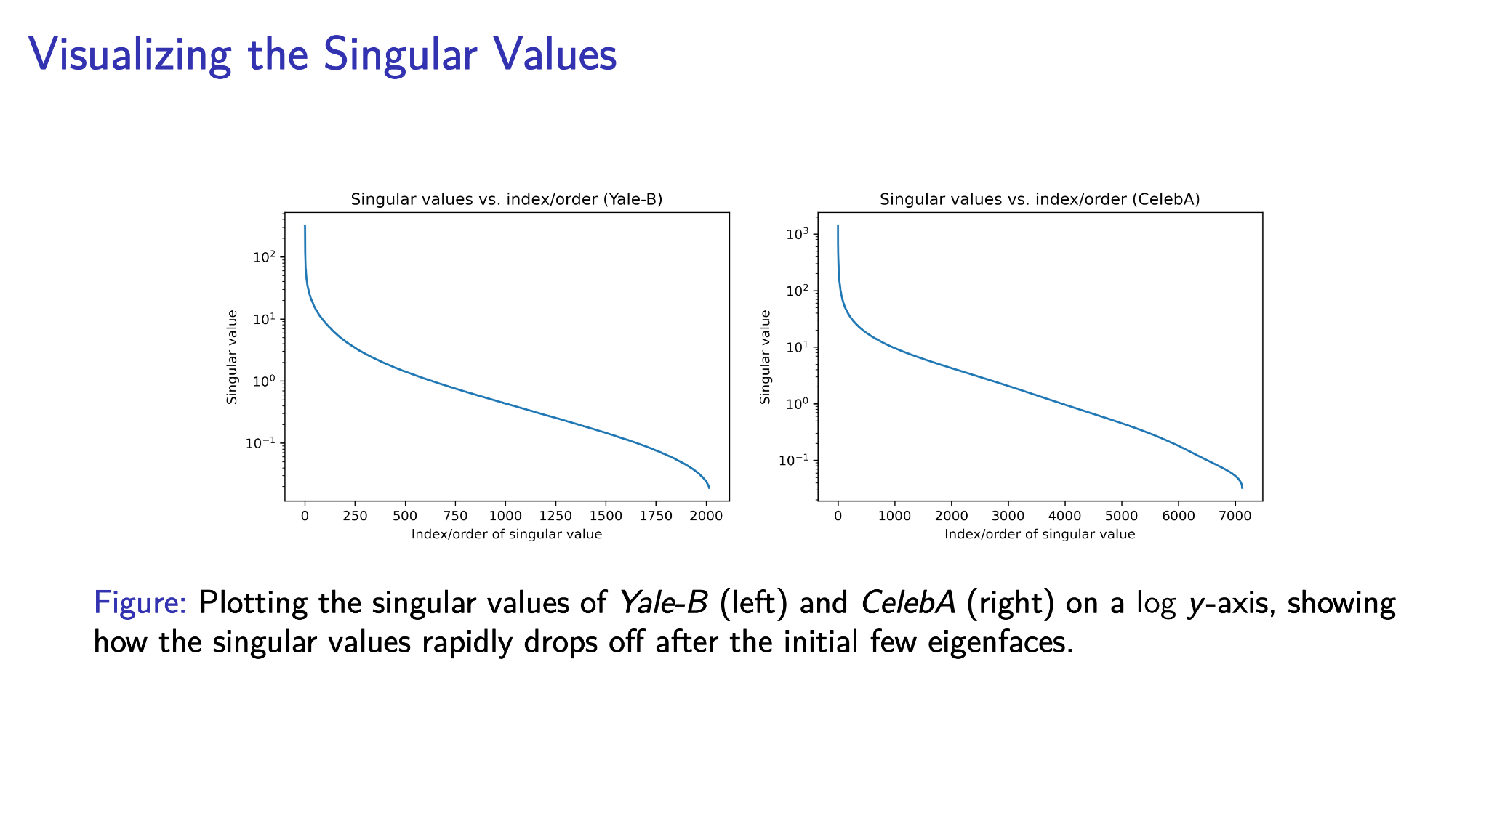

Slide 9
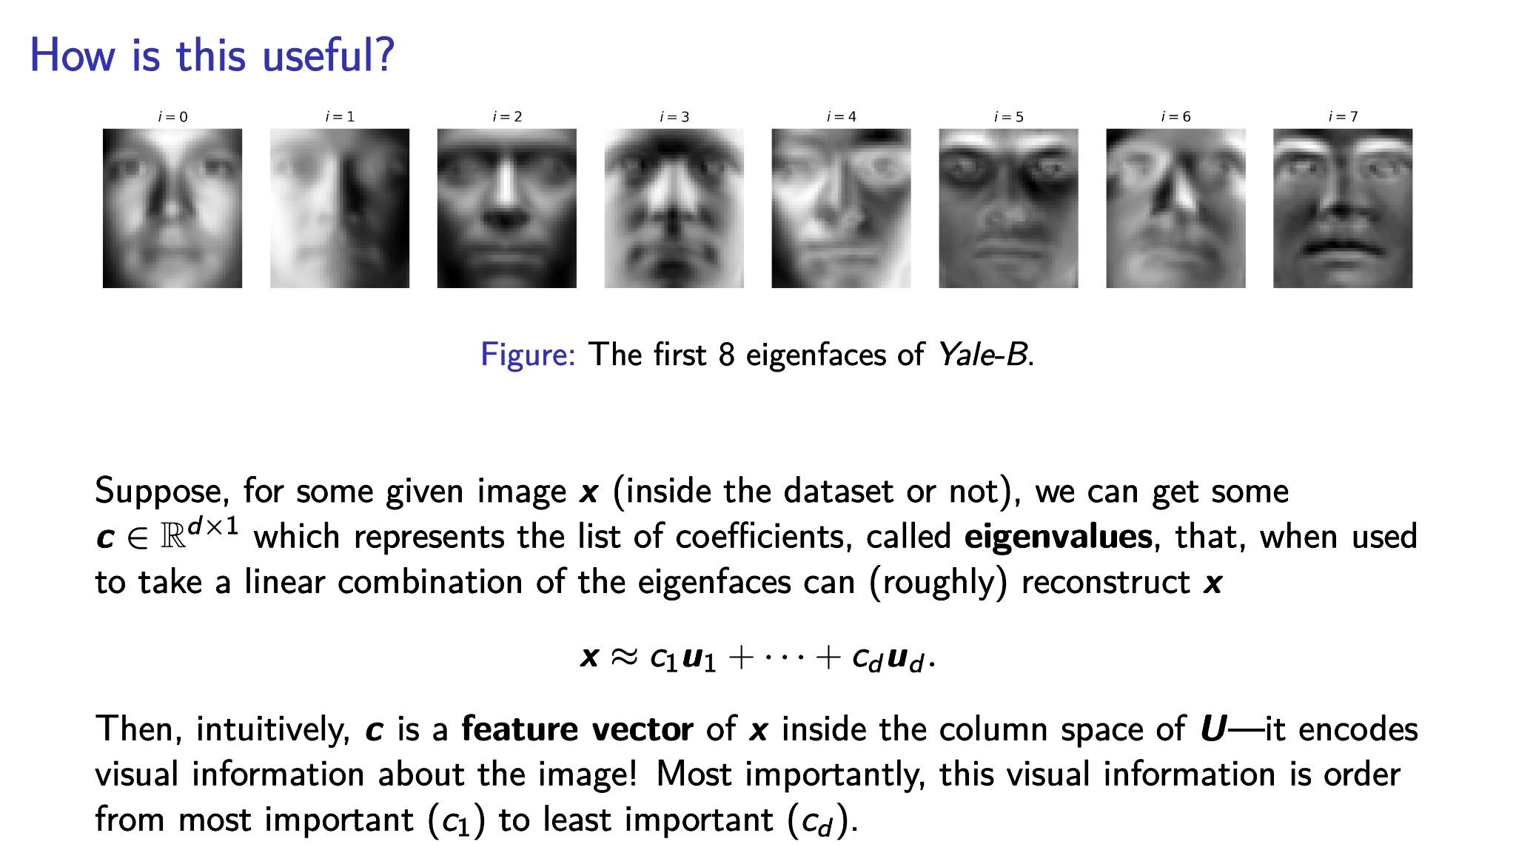

Slide 10
Projection
Introduction
Projection
Image Compression
Image Denoising
Tuning Light
Facial Feature Recovery
Facial Classification

Slide 11
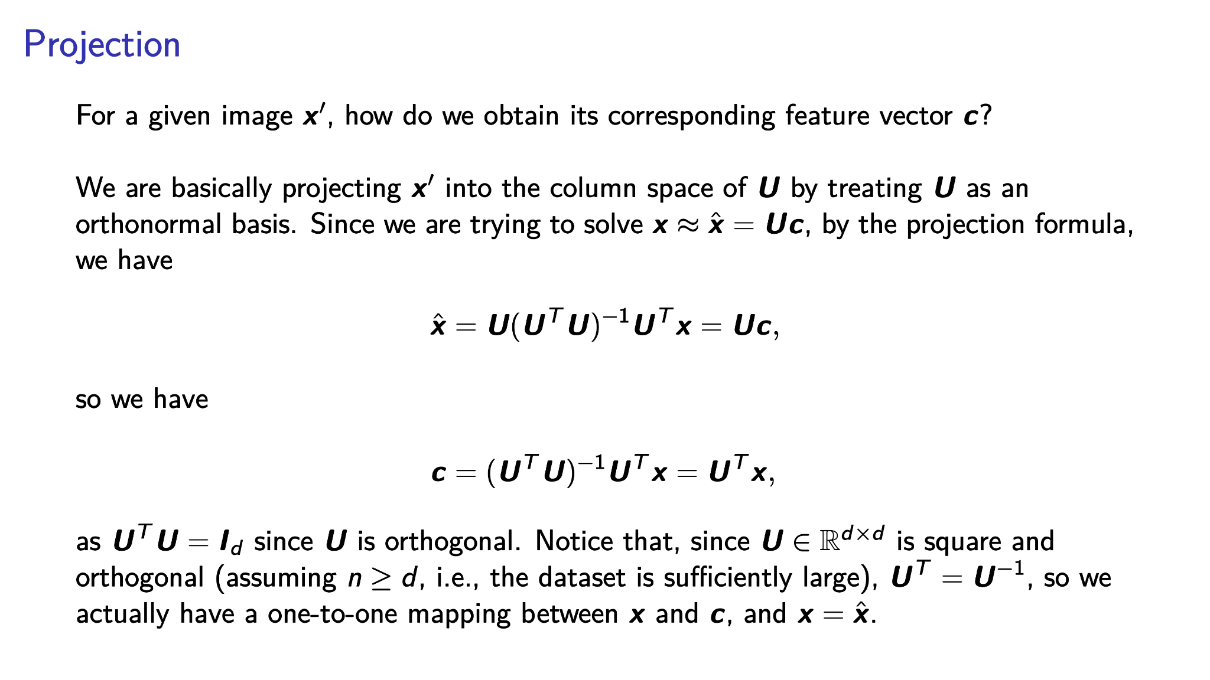

Slide 12
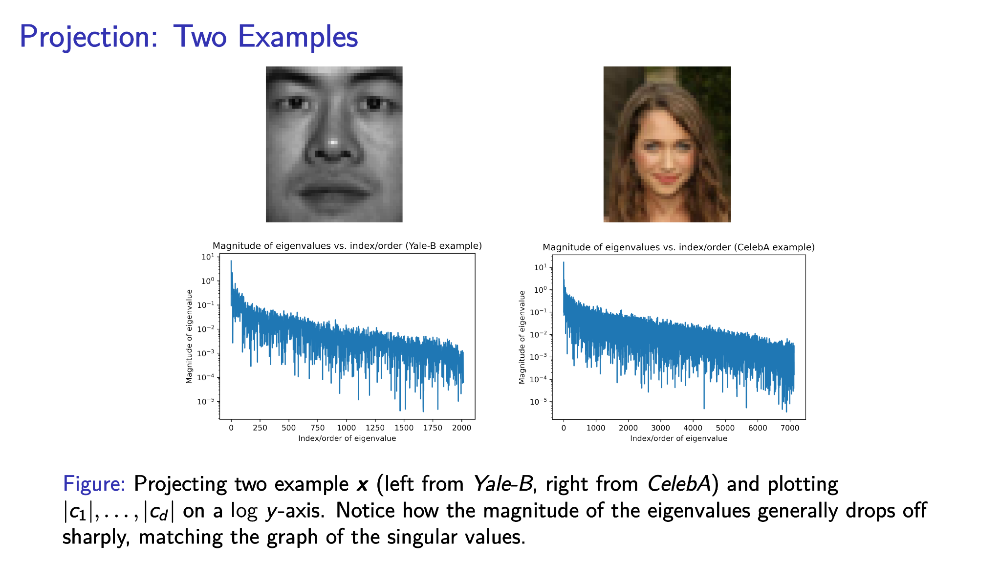

Slide 13
Image Compression
Introduction
Projection
Image Compression
Image Denoising
Tuning Light
Facial Feature Recovery
Facial Classification

Slide 14
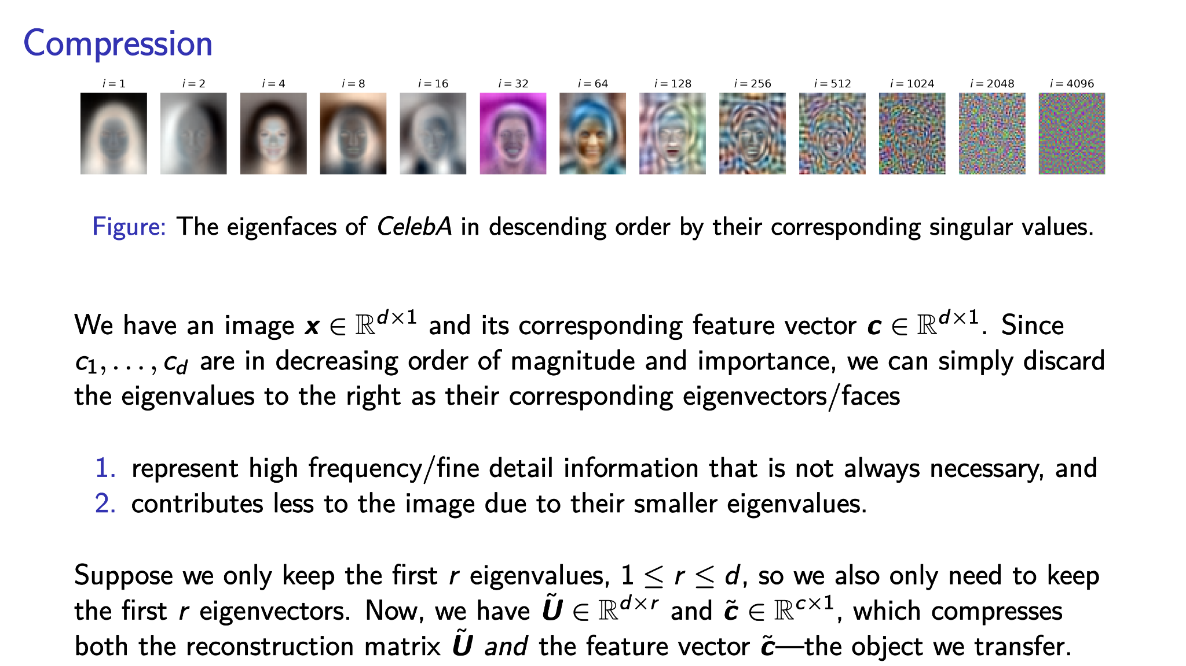

Slide 15
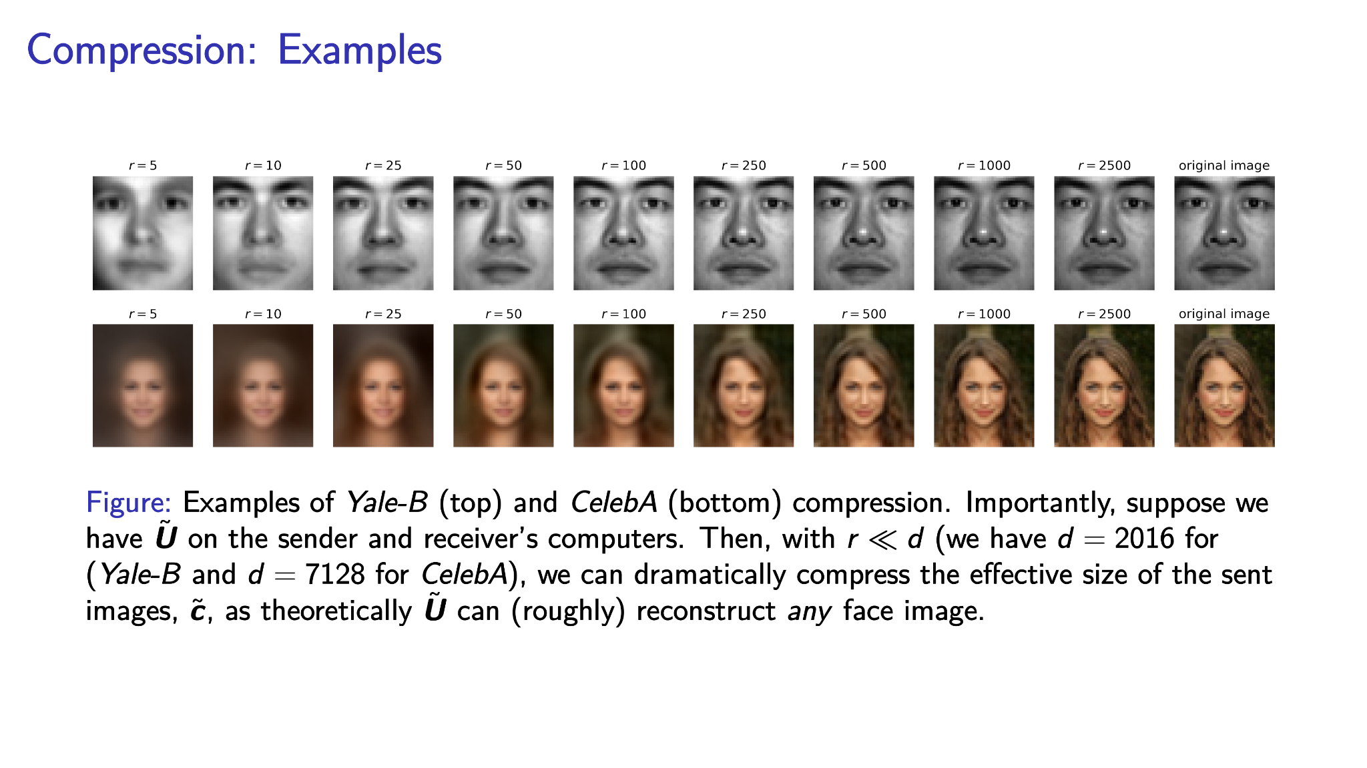

Slide 16
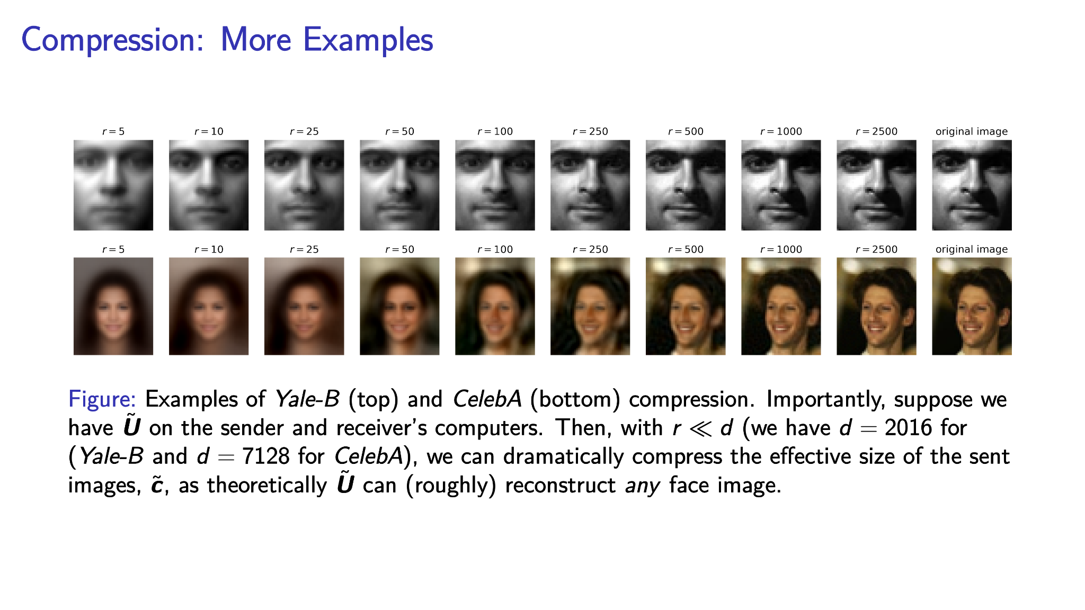

Slide 17
The General Algorithm
From this, we have the following general algorithm for any form of image restoration/reconstruction, i.e., using the eigenfaces to only retain the most important information and thus remove unwanted information (e.g., noise).
Given some input image x and eigenface cut-off point r …
Compute c = U^{T} x.
Only keep the first r values of c to get c_{small} (i.e., chop off the right of c).
Compute x_{reconstructed} = U c_{small}.
We have successfully used SVD to process images!

Slide 18
Image Denoising
Introduction
Projection
Image Compression
Image Denoising
Tuning Light
Facial Feature Recovery
Facial Classification

Slide 19

Random
Trivial Information
In other words, noise is high frequency information that usually comprises a relatively small/trivial part of the image.

Slide 20
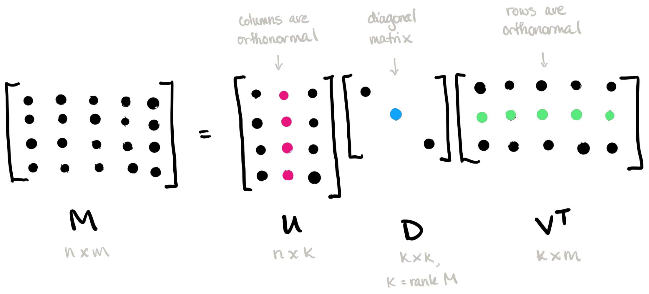
Finding the main pattern
Chopping off the irrelevant details
Note that this is applied to one single image and does not require a dataset! Intuitively, U encodes patterns across the horizontal direction of M and V encodes patterns across the vertical direction. We chop them off on the right because the column vectors, i.e., the patterns, are ordered from most to least significant—the least significant/highest frequency patterns are exactly the noise! (This is a bit different than what we just saw.)

Slide 21
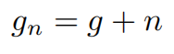
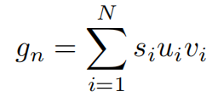
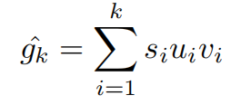
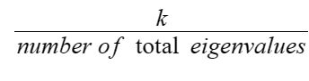
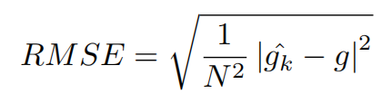
Let’s see how SVD could deal with noises
First we add random noise to our cleaned image
Apply SVD to the noisy image
Compute the image approximations (5%-95%)
Compute the Root Mean Square Error (RSME)

Slide 22
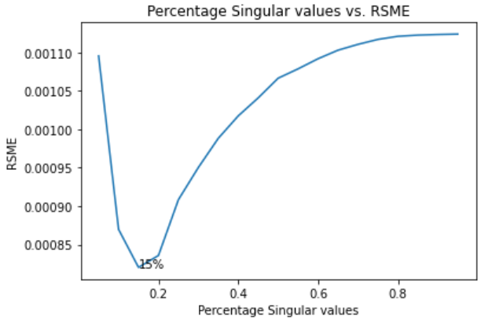
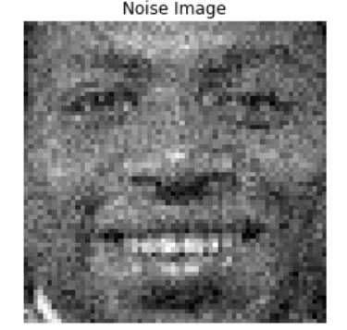

Slide 23
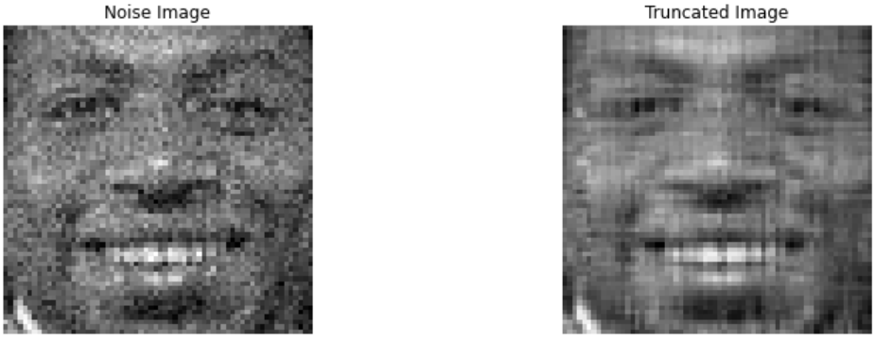
Chopping off the rest 85% of the information

Slide 24
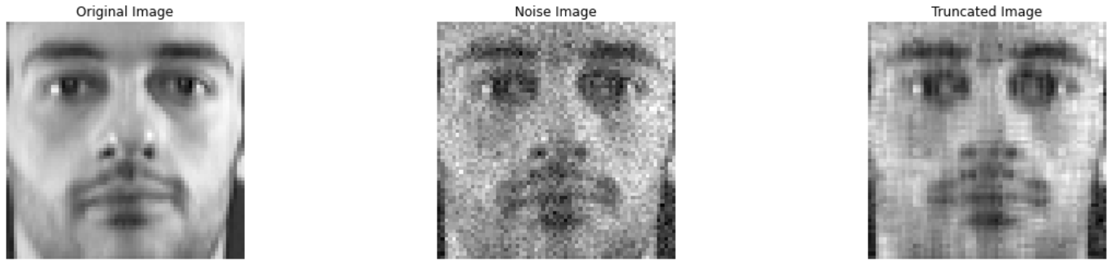
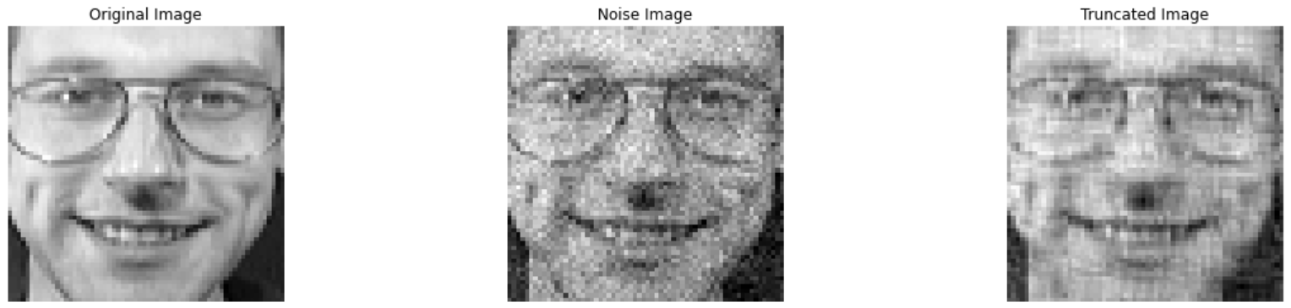

Slide 25
Learn eigenfaces from a dataset of different faces with noise
PCA

Slide 26
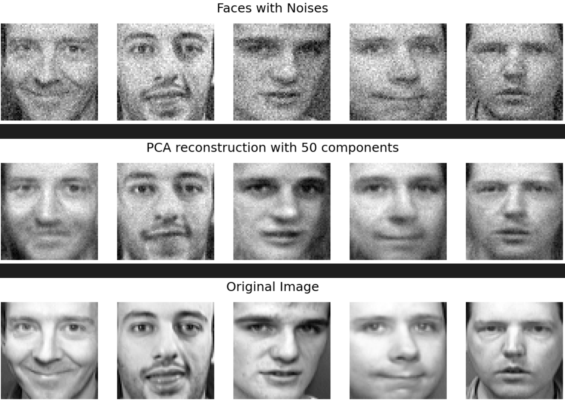
Olivetti Face Denoising Examples

Slide 27
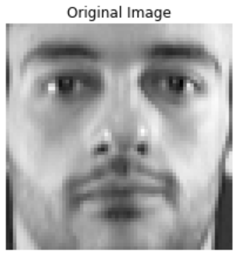
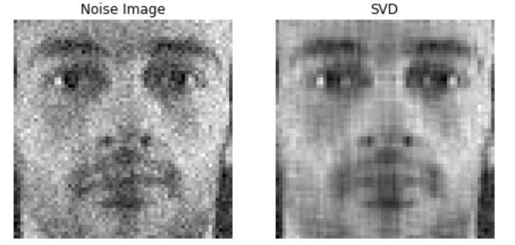
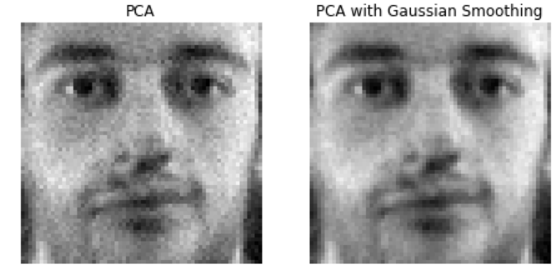
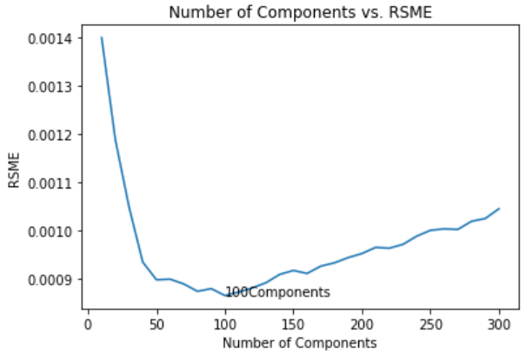

Slide 28
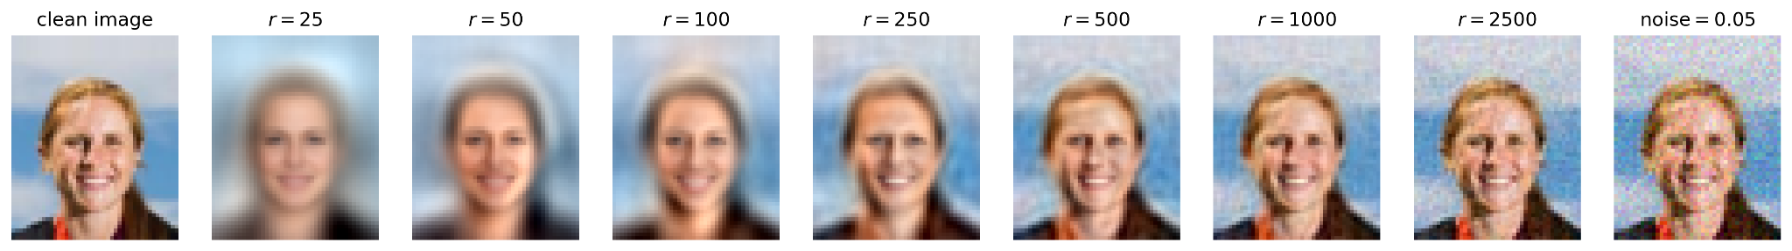
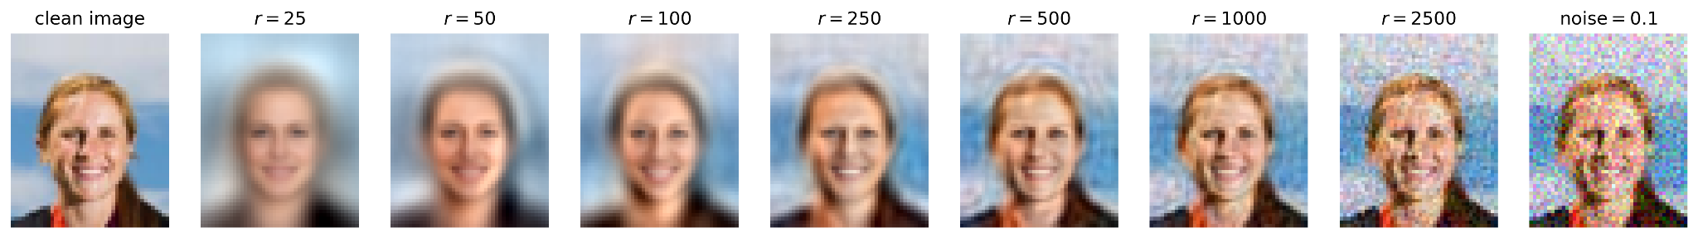
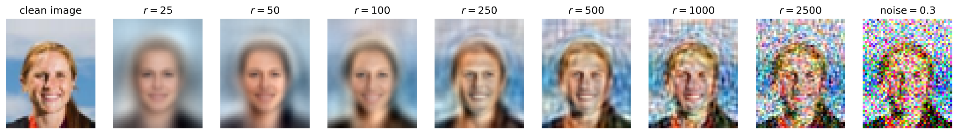
CelebA Face Denoising Examples

Slide 29
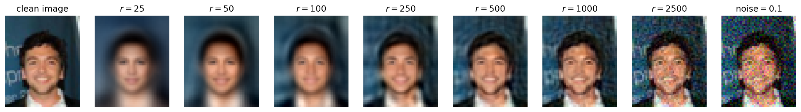
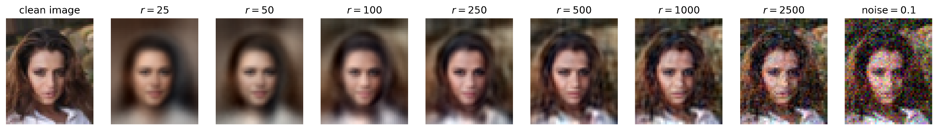
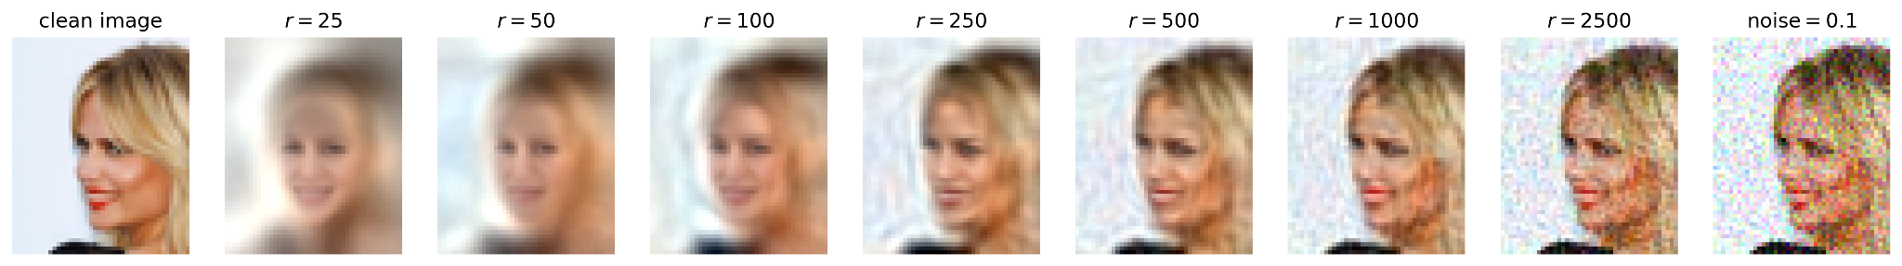
CelebA Face Denoising Examples

Slide 30
Tuning Light
Introduction
Projection
Image Compression
Image Denoising
Tuning Light
Facial Feature Recovery
Facial Classification

Slide 31
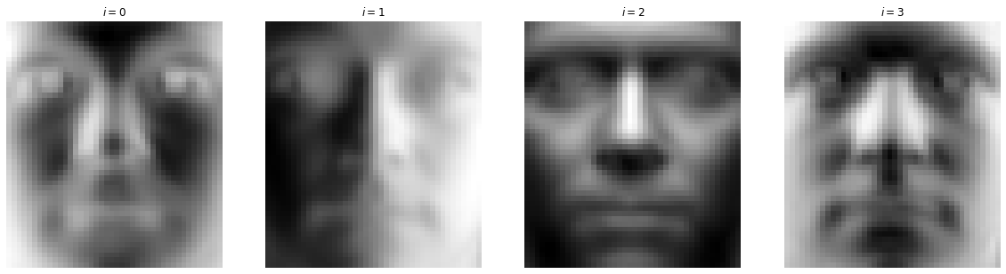
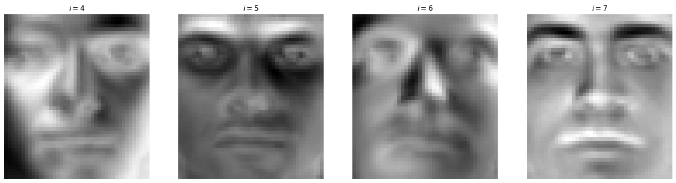
The First 8 Eigenfaces (Yale-B)

Slide 32
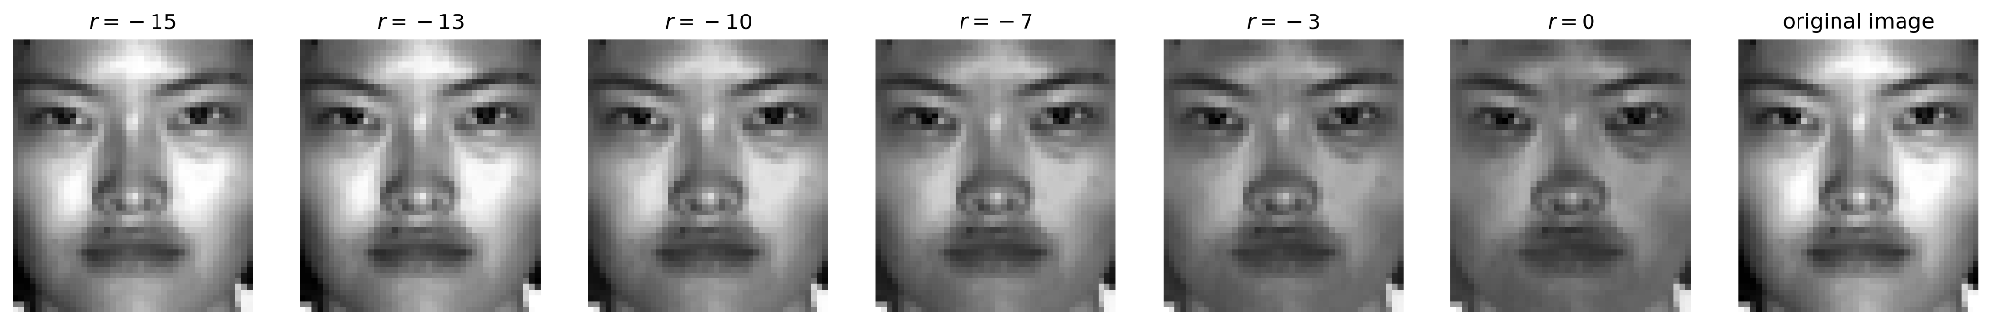
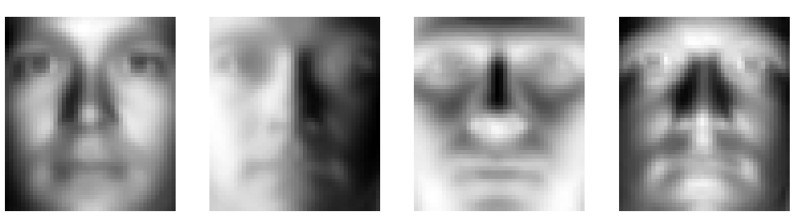
Lighting Contrast
Inverted so you can see better

Slide 33
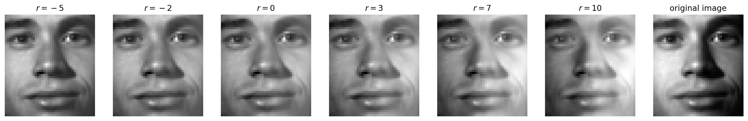
Left–Right

Slide 34
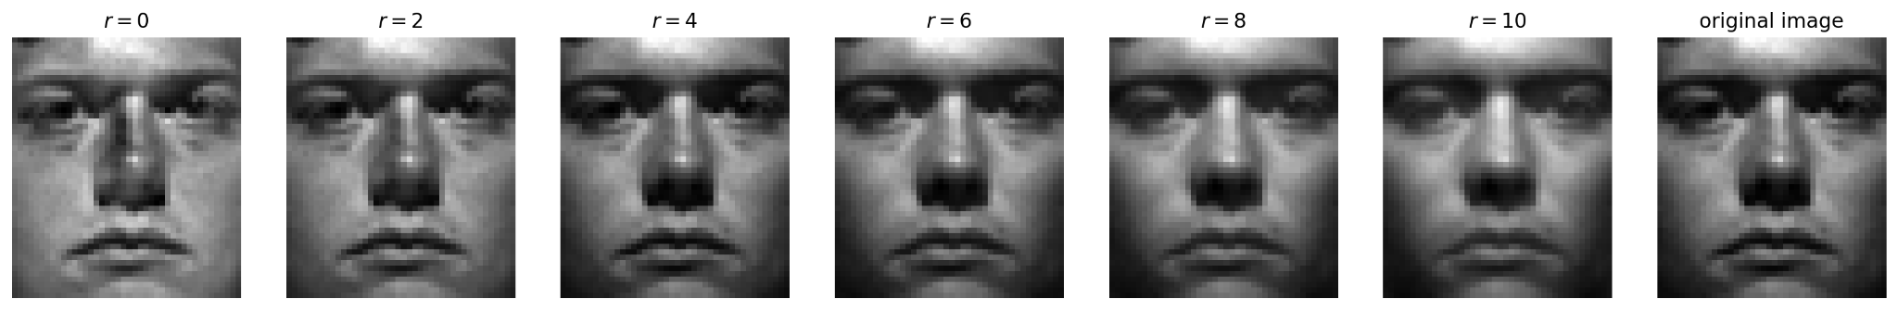
Top–Bottom

Slide 35
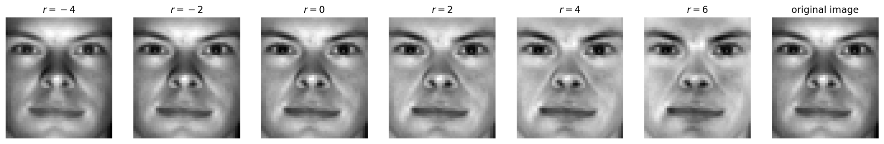
Underglow
Inverted so you can see better

Slide 36
Facial Feature Recovery
Introduction
Projection
Image Compression
Image Denoising
Tuning Light
Facial Feature Recovery
Facial Classification

Slide 37
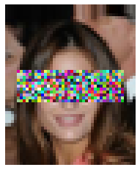
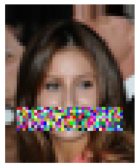
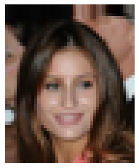
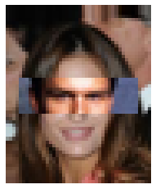
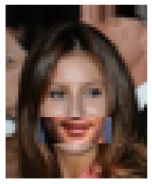
Lost Facial Features
?

Slide 38
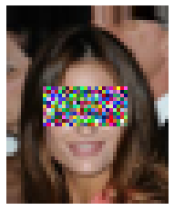
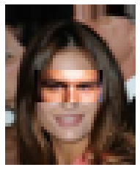
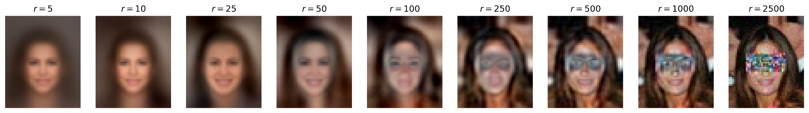
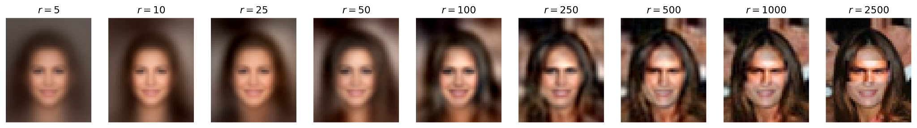
Covered Eyes

Slide 39



Covered Mouth

Slide 40





Comparing the Optimal Threshold Output
r = 50
r = 140
Original
r = 200
r = 130

Slide 41







Even More Crazier?
Original

Slide 42





Combining Two Faces

Slide 43





Mixing Two Faces

Slide 44
Facial Classification
Introduction
Projection
Image Compression
Image Denoising
Tuning Light
Facial Feature Recovery
Facial Classification

Slide 45

Facial Classification
The Goal: Take a previously unseen image, and classify it against a set of known “identities”—i.e. people—and their known images.
The Dilemma: Pictures of the same person can have drastically different lighting and poses. This means we cannot directly compare images of faces!
Each person in our dataset has 9 training faces and 1 test face.
The Olivetti Faces Dataset.

Slide 46


Classification Example
?

Slide 47

How SVD Helps Classification
Like discussed previously, we can use the matrix U to send our image into features space!
This is similar to the Fourier Transform, except we are selecting for abstract features instead of frequencies.
We then ignore the features representing lighting and pose information and compare the remaining, identity specific, information.
U
*Brightness was increased

Slide 48


Classification Method 1: Averaging
Find the average feature f_{i} vector of all images for each identity i.
Find the feature vector v of an image with unknown identity
Only focus on elements 20-200 of each.
Find the identity with the smallest distance to feature vector v.
I.e. find i to minimize norm(f_{i} - v)
Now i is the predicted identity!
This method has:
~ 50% accuracy for 2 faces
~20% accuracy for 20 faces
~75% accuracy for 40 faces

Slide 49

Classification Method 2: K-Nearest Neighbors
Project all known images into “feature space” and remember their identities.
Find the feature vector of v our image with unknown identity
Only focus on elements 20-200 of each.
Find the k = 6 nearest known feature vectors.
Pick the most frequent identity among those nearest vectors.
This method has:
~ 100% accuracy for 2 faces
~80% accuracy for 20 faces
~85% accuracy for 40 faces
Figure Credit: Analytics Vidhya

Slide 50
Thanks for Listening!
SVD is cool and you should use it more :)

Slide 51
References
“Projections Onto Subspaces.” 18.06SC Linear Algebra, MIT OpenCourseWare, https://ocw.mit.edu/courses/18-06sc-linear-algebra-fall-2011/00e9c8f0eafedeab21a3d079a17ed3d8_MIT18_06SCF11_Ses2.2sum.pdf.
Guoliang Zeng, “Facial Recognition with Singular Value Decomposition.” In: Elleithy, K. (eds) Advances and Innovations in Systems, Computing Sciences and Software Engineering. Springer, Dordrecht.
Phillip K Poon, “Image Denoising with Singular Value Decomposition and Principal Component Analysis”, December 2009.
Steve Brunton, “Singular Value Decomposition [Data-Driven Science and Engineering]” YouTube, uploaded by Steve Brunton, 8 October. 2022, https://www.youtube.com/playlist?list=PLMrJAkhIeNNSVjnsviglFoY2nXildDCcv.

